Slide 2
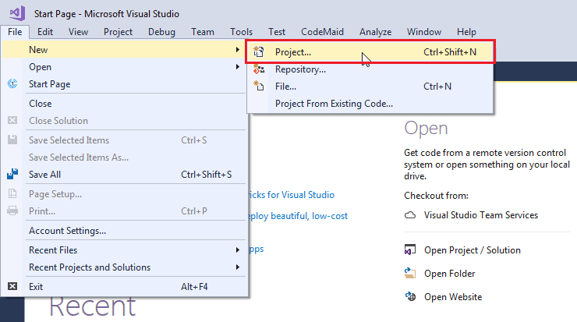

Slide 3
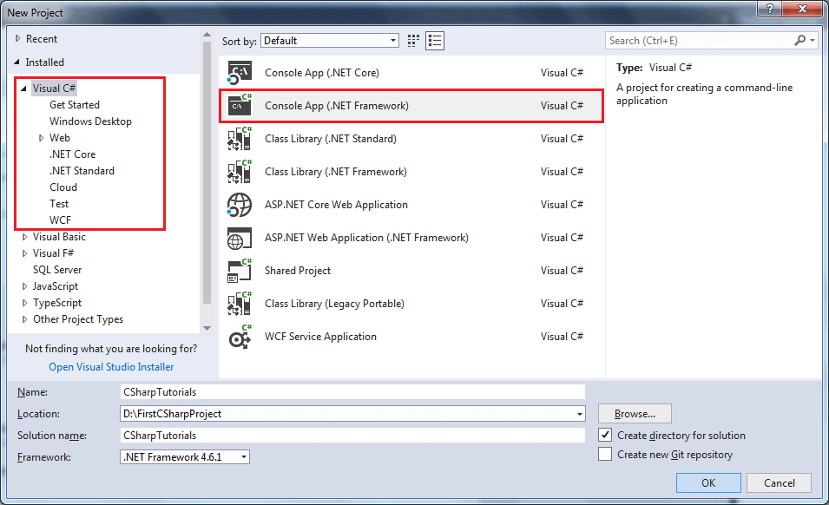

Slide 4
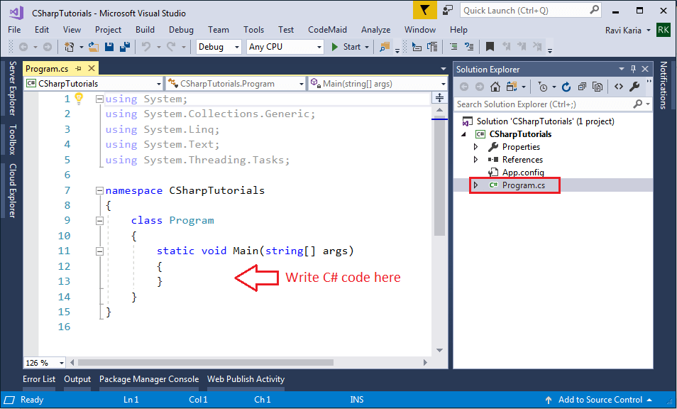

Slide 5
using System;
using System.Collections.Generic;
using System.Linq;
using System.Text;
using System.Threading.Tasks;
namespace CSharpTutorials
{
class Program
{
static void Main(string[] args)
{
string message = "Hello World!!";
Console.WriteLine(message);
}
}
}

Slide 6
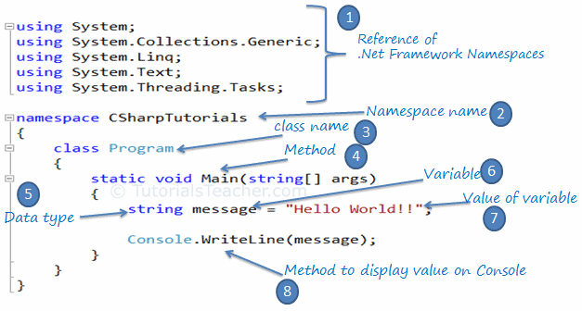
Every console application starts from the Main() method of the Program class. The following example displays "Hello World!!" on the console. z

Slide 7
Every .NET application takes the reference of the necessary .NET framework namespaces that it is planning to use with the using keyword, e.g., using System.Text.
Declare the namespace for the current class using the namespace keyword, e.g., namespace CSharpTutorials.FirstProgram
We then declared a class using the class keyword: class Program
The Main() is a method of Program class is the entry point of the console application.
String is a data type.
A message is a variable that holds the value of a specified data type.
"Hello World!!" is the value of the message variable.
The Console.WriteLine() is a static method, which is used to display a text on the console.

